Slide 1
Fundamentals of Software Engineering
LECTURE 13:SEQUENCE DIAGRAM

Slide 2
Interaction diagram
Interaction diagram
An interaction diagram is used to show the interactive behavior of a system. Since visualizing the interactions in a system can be a cumbersome task, we use different types of interaction diagrams to capture various features and aspects of interaction in a system. A sequence diagram is the most commonly used interaction diagram.

Slide 3
Sequence Diagrams
A sequence diagram simply depicts interaction between objects in a sequential order i.e. the order in which these interactions take place.
We can also use the terms event diagrams or event scenarios to refer to a sequence diagram. Sequence diagrams describe how and in what order the objects in a system function.
These diagrams are widely used by businessmen and software developers to document and understand requirements for new and existing systems.

Slide 4
Benefits of sequence diagrams
Sequence diagrams can be useful references for businesses and other organizations. Try drawing a sequence diagram to:
Represent the details of a UML use case.
Model the logic of a sophisticated procedure, function, or operation.
See how objects and components interact with each other to complete a process.
Plan and understand the detailed functionality of an existing or future scenario.

Slide 5
Purpose of Sequence Diagram
Model high-level interaction between active objects in a system
Model the interaction between object instances within a collaboration that realizes a use case
Model the interaction between objects within a collaboration that realizes an operation
Either model generic interactions (showing all possible paths through the interaction) or specific instances of a interaction (showing just one path through the interaction)

Slide 6
Uses of sequence diagrams
Used to model and visualise the logic behind a sophisticated function, operation or procedure.
They are also used to show details of UML use case diagrams.
Used to understand the detailed functionality of current or future systems.
Visualise how messages and tasks move between objects or components in a system.

Slide 7
Use cases for sequence diagrams
The following scenarios are ideal for using a sequence diagram:
Usage scenario: A usage scenario is a diagram of how your system could potentially be used. It's a great way to make sure that you have worked through the logic of every usage scenario for the system.
Method logic: Just as you might use a UML sequence diagram to explore the logic of a use case, you can use it to explore the logic of any function, procedure, or complex process.
Service logic: If you consider a service to be a high-level method used by different clients, a sequence diagram is an ideal way to map that out.

Slide 8
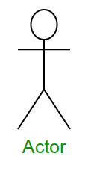
Sequence Diagram Notations
Actors – An actor in a UML diagram represents a type of role where it interacts with the system and its objects. It is important to note here that an actor is always outside the scope of the system we aim to model using the UML diagram.

Slide 9
Actors
We use actors to depict various roles including human users and other external subjects. We represent an actor in a UML diagram using a stick person notation. We can have multiple actors in a sequence diagram.
For example – Here the user in seat reservation system is shown as an actor where it exists outside the system and is not a part of the system.

Slide 10
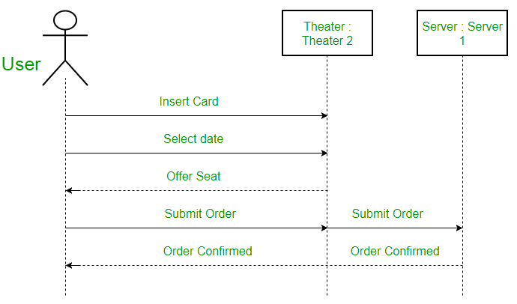
Actors

Slide 11
Lifelines
A lifeline is a named element which depicts an individual participant in a sequence diagram. So basically each instance in a sequence diagram is represented by a lifeline.
Lifeline elements are located at the top in a sequence diagram.
The standard in UML for naming a lifeline follows the following format
Instance Name : Class Name

Slide 12
Lifelines
We display a lifeline in a rectangle called head with its name and type. The head is located on top of a vertical dashed line (referred to as the stem). If we want to model an unnamed instance, we follow the same pattern except now the portion of lifeline’s name is left blank.

Slide 13
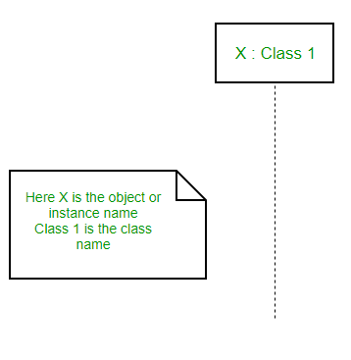
Lifelines

Slide 14
Lifelines
Represents the passage of time as it extends downward. This dashed vertical line shows the sequential events that occur to an object during the charted process. Lifelines may begin with a labeled rectangle shape or an actor symbol.

Slide 15
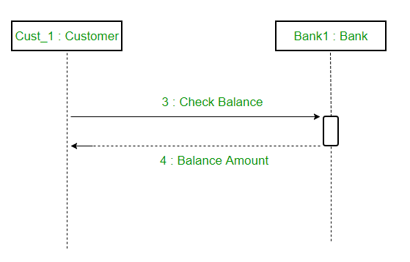
Difference between a lifeline and an actor
A lifeline always portrays an object internal to the system whereas actors are used to depict objects external to the system. The following is an example of a sequence diagram:

Slide 16

Activations
A thin rectangle on a lifeline) represents the period during which an element is performing an operation.
The top and the bottom of the of the rectangle are aligned with the initiation and the completion time respectively

Slide 17
Activation bar
Represents the time needed for an object to complete a task.
The longer the task will take, the longer the activation box becomes.

Slide 18
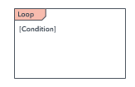
Option loop
Used to model if/then scenarios, i.e., a circumstance that will only occur under certain conditions.

Slide 19
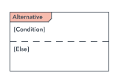
Alternative
Symbolizes a choice (that is usually mutually exclusive) between two or more message sequences. To represent alternatives, use the labeled rectangle shape with a dashed line inside.

Slide 20
Common message symbols
Communication between objects is depicted using messages. The messages appear in a sequential order on the lifeline. We represent messages using arrows. Lifelines and messages form the core of a sequence diagram.

Slide 21

Synchronous message symbol
Represented by a solid line with a solid arrowhead.
This symbol is used when a sender must wait for a response to a message before it continues.
The diagram should show both the call and the reply.

Slide 22
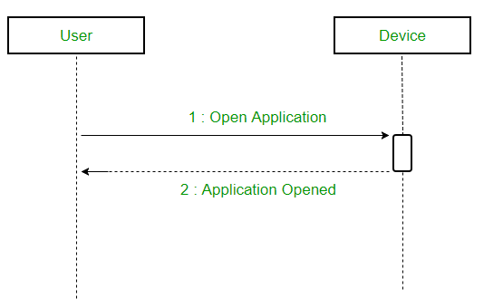
Synchronous message symbol

Slide 23

Common message symbols
Asynchronous message
Represented by a solid line with a lined arrowhead.
Asynchronous messages don't require a response before the sender continues.
Only the call should be included in the diagram.

Slide 24
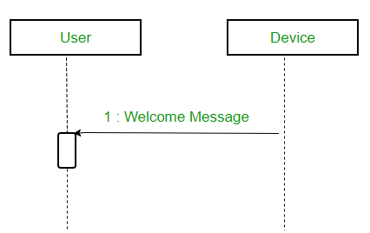
Asynchronous message

Slide 25

Common message symbols
create message
We use a Create message to instantiate a new object in the sequence diagram. This message creates a new object.
There are situations when a particular message call requires the creation of an object.
It is represented with a dotted arrow and create word labeled on it to specify that it is the create Message symbol.

Slide 26
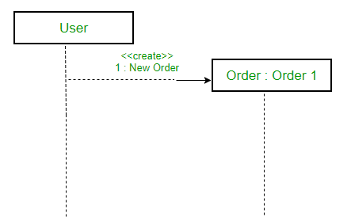
create message
For example – The creation of a new order on a e-commerce website would require a new object of Order class to be created.

Slide 27

Common message symbols
Reply message
Represented by a dashed line with a lined arrowhead.
These messages are replies to calls.
Reply messages are used to show the message being sent from the receiver to the sender.
We represent a return/reply message using an open arrowhead with a dotted line.
The interaction moves forward only when a reply message is sent by the receiver.

Slide 28
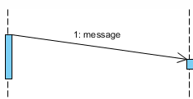
Common message symbols
Duration Message
Duration message shows the distance between two time instants for a message invocation.

Slide 29
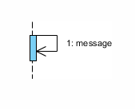
Common message symbols
Self Message
Self message is a kind of message that represents the invocation of message of the same lifeline.
Certain scenarios might arise where the object needs to send a message to itself
Such messages are called Self Messages and are represented with a U shaped arrow.

Slide 30
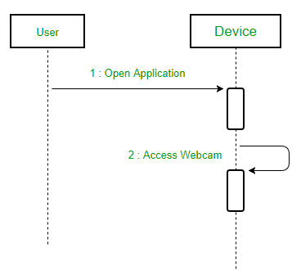
Self Message
For example – Consider a scenario where the device wants to access its webcam. Such a scenario is represented using a self message.

Slide 31
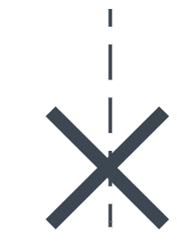
Common message symbols
Delete message
We use a Delete Message to delete an object.
When an object is deallocated memory or is destroyed within the system we use the Delete Message symbol. It destroys the occurrence of the object in the system.
It is represented by an arrow terminating with a x.

Slide 32
Delete message
For example – In the scenario below when the order is received by the user, the object of order class can be destroyed.

Slide 33
Sequence fragments
UML 2.0 introduces sequence (or interaction) fragments. Sequence fragments make it easier to create and maintain accurate sequence diagrams
A sequence fragment is represented as a box, called a combined fragment, which encloses a portion of the interactions within a sequence diagram
The fragment operator (in the top left cornet) indicates the type of fragment
Fragment types: ref, assert, loop, break, alt, opt, neg

Slide 34
alt | Alternative multiple fragments: only the one whose condition is true will execute.
opt | Optional: the fragment executes only if the supplied condition is true. Equivalent to an alt only with one trace.
par | Parallel: each fragment is run in parallel.
loop | Loop: the fragment may execute multiple times, and the guard indicates the basis of iteration.
region | Critical region: the fragment can have only one thread executing it at once.
neg | Negative: the fragment shows an invalid interaction.
ref | Reference: refers to an interaction defined on another diagram. The frame is drawn to cover the lifelines involved in the interaction. You can define parameters and a return value.
sd | Sequence diagram: used to surround an entire sequence diagram.

Slide 35
How to Draw a Sequence Diagram
A sequence diagram represents the scenario or flow of events in one single use case.
The message flow of the sequence diagram is based on the narrative of the particular use case.
Then, before you start drawing the sequence diagram or decide what interactions should be included in it, you need to draw the use case diagram and ready a comprehensive description of what the particular use case does.

Slide 36
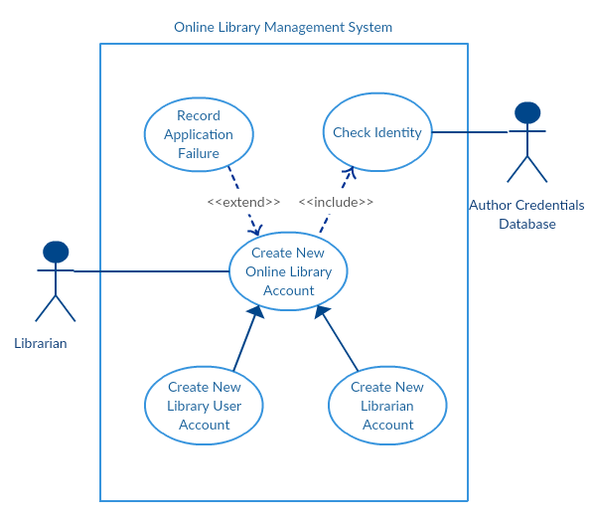

Slide 37
How to Draw a Sequence Diagram
From the above use case diagram example of ‘Create New Online Library Account’, we will focus on the use case named ‘Create New User Account’ to draw our sequence diagram example.
Before drawing the sequence diagram, it’s necessary to identify the objects or actors that would be involved in creating a new user account. These would be;
Librarian
Online Library Management system
User credentials database
Email system

Slide 38
How to Draw a Sequence Diagram
Once you identify the objects, it is then important to write a detailed description on what the use case does. From this description, you can easily figure out the interactions (that should go in the sequence diagram) that would occur between the objects above, once the use case is executed.

Slide 39
How to Draw a Sequence Diagram
Here are the steps that occur in the use case named ‘Create New Library User Account’.
The librarian request the system to create a new online library account
The librarian then selects the library user account type
The librarian enters the user’s details
The user’s details are checked using the user Credentials Database
The new library user account is created
A summary of the new account’s details are then emailed to the user

Slide 40
How to Draw a Sequence Diagram
From each of these steps, you can easily specify what messages should be exchanged between the objects in the sequence diagram. Once it’s clear, you can go ahead and start drawing the sequence diagram.
The sequence diagram below shows how the objects in the online library management system interact with each other to perform the function ‘Create New Library User Account’.

Slide 41
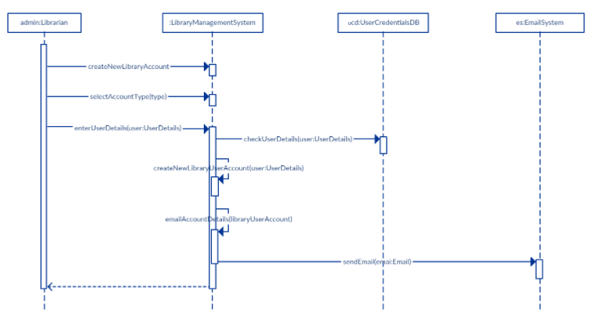

Slide 42
Sequence Diagram Common Mistakes
When drawing sequence diagrams, designers tend to make these common mistakes. By avoiding these mistakes you can ensure the quality of your diagram.
Adding too much detail. This clutters up the diagram and makes it difficult to read.
Leaving no blank space between the use case text and the message arrow; this makes it difficult for anyone to read the diagram.
Not considering the origins of message arrows carefully.

Slide 43
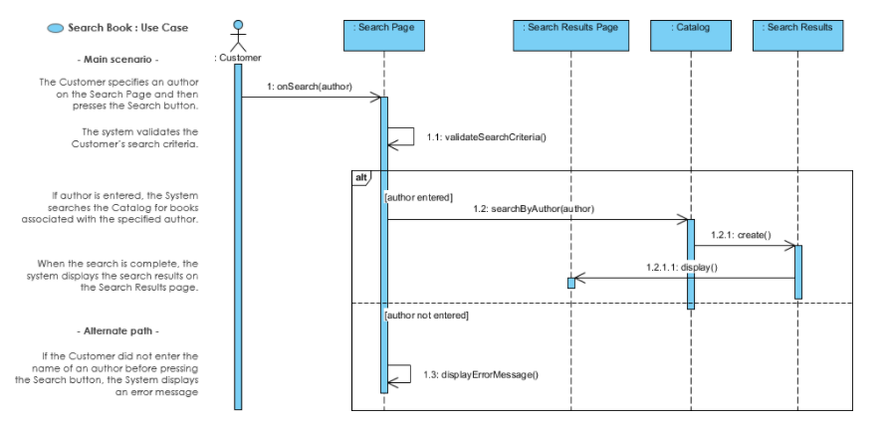

Slide 44
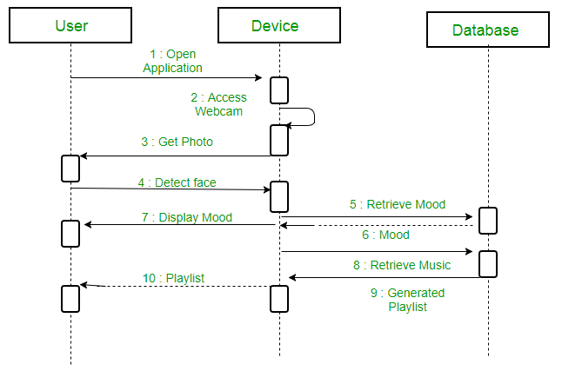
a sequence diagram for an emotion based music player

Slide 45
a sequence diagram for an emotion based music player
Firstly the application is opened by the user.
The device then gets access to the web cam.
The webcam captures the image of the user.
The device uses algorithms to detect the face and predict the mood.
It then requests database for dictionary of possible moods.
The mood is retrieved from the database.
The mood is displayed to the user.
The music is requested from the database.
The playlist is generated and finally shown to the user.

Slide 46
